Slide 1
INTERNAL CONTROLS
Best Practices and What Can Wrong
Notes:
HOW TO: Add a background - Right click on slide in the panel on the left side, select “Format background” and add an image to the background.

Slide 2
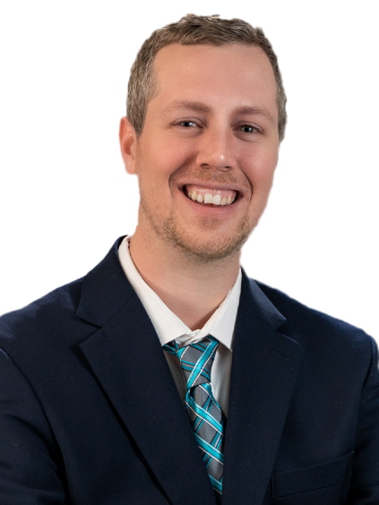
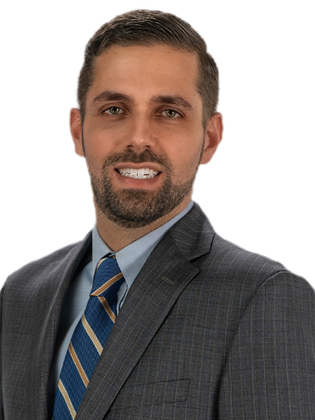
Benjamin has over six years of accounting and auditing experience. He works on audits, compilations and reviews and is a key member of our Government Services Team. The vast majority of his efforts focus on government entities, nonprofit organizations, and higher education entities, giving him in-depth knowledge of Uniform Guidance and other federal and state audit guidelines.
Ben Clark, CPA
Manager
Andrew has nearly five years of professional accounting and serves on our Government Services Team. His work primarily focuses on our government and nonprofit clients, specifically regarding audits, compilations and reviews for local government organizations throughout Florida.
Andrew Ferguson, CPA
Senior Accountant

Slide 3
Agenda
Internal Control
Evaluating specific control-related policies and procedures
BCOSO Framework Refresher
Principles and Points of Focus
Story Time!
Q&A
Florida Governments and Beyond

Slide 4
COSO Framework Refresher

Slide 5
COSO Framework – Internal Control
Definition of Internal Control:
“Internal Control is a process, affected by an entity’s board of directors, management, and other personnel, designed to provide reasonable assurance regarding the achievement of objectives relating to operations, reporting, and compliance.”

Slide 6
COSO Framework – Internal Control
Weak internal controls…
The not only permit fraud, they actually encourage it.

Slide 7
COSO Framework – Internal Control
Categories of Objectives:
Operations
Reporting
Compliance
Five Components of Internal Control
Control Environment
Risk Assessment
Control Activities
Information & Communication
Monitoring Activities

Slide 8
COSO Framework – Principles
Control Environment
Demonstrates commitment to integrity and ethical values
Exercises oversight responsibility
Establishes structure, authority and responsibility
Demonstrates commitment to competence
Enforces accountability
Risk Assessment
Specifies suitable objectives
Identifies and analyzes risk
Assesses fraud risk
Identifies and analyzes significant change
Control Activities
Selects and develops control activities
11. Selects and develops general controls over technology
Deploys through policies and procedures
Information & Communication
Uses relevant information
Communicates internally
Communicates externally
Monitoring Activities
Conducts ongoing and/or separate evaluations
Evaluates and communicates deficiencies

Slide 9
COSO Framework – Requirements for Effectiveness
Each principle must be present and functioning for the related component to be considered present and functioning.
Present – relevant principles exist in the design and implementation of the system of internal control to achieve specified objectives
Functioning – relevant principles continue to exist in the conduct of the system of internal control to achieve specified objectives
Auditor Assessment: “Design and Implementation”
Not one-size-fits-all

Slide 10
COSO Alert
Internal Control Assessment Consideration
The role of the external auditors in your organization’s internal control
Potential Deficiency
External auditors may NOT be a part of an auditee’s internal control. Any assessment of this being the case is either a) lacking in the true assessment of internal controls within the entity or b) indicative of a lack of independence of the auditor.

Slide 11
COSO: Risk Assessment Principle 8
Risk Assessment Component
(Principle 8)
The Fraud Triangle
The organization considers the potential for fraud in assessing risks to the achievement of objectives
Point of Focus
Opportunity
Considers various types of fraud
Assesses incentives and pressures
Assesses opportunities
Assesses attitudes and rationalizations
Rationalization
Pressure

Slide 12
COSO Framework – Internal Control – Group Reflection
Open Question:
What are some examples in your organization where you see “weak” internal controls or areas where internal controls can be improved?

Slide 13
COSO Framework – Internal Control – Group Reflection
Open Question:
If you were a fraudster, and were looking to commit fraud in your organization, how would you commit it?

Slide 14
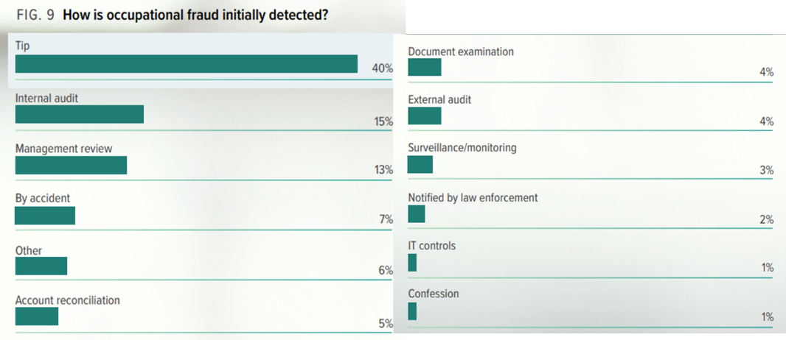
Fraud Detection
2018 Report to the Nations, ACFE

Slide 15
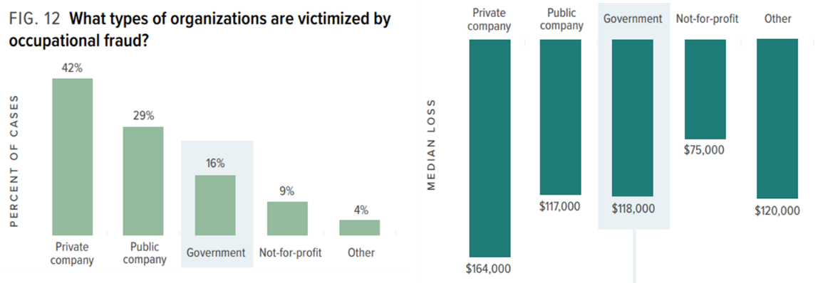
Fraud Detection (cont.)
Victims of Fraud – By Type of Organization (2018 Report to the Nations, ACFE)

Slide 16
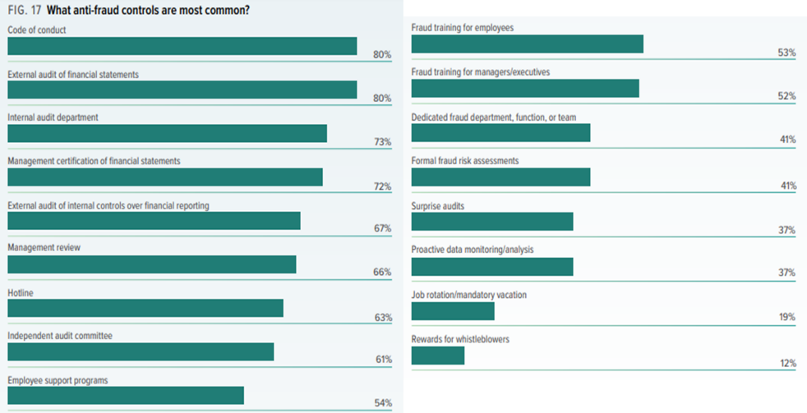
Fraud Detection (cont.)
Anti-Fraud Controls (2018 Report to the Nations, ACFE)

Slide 17
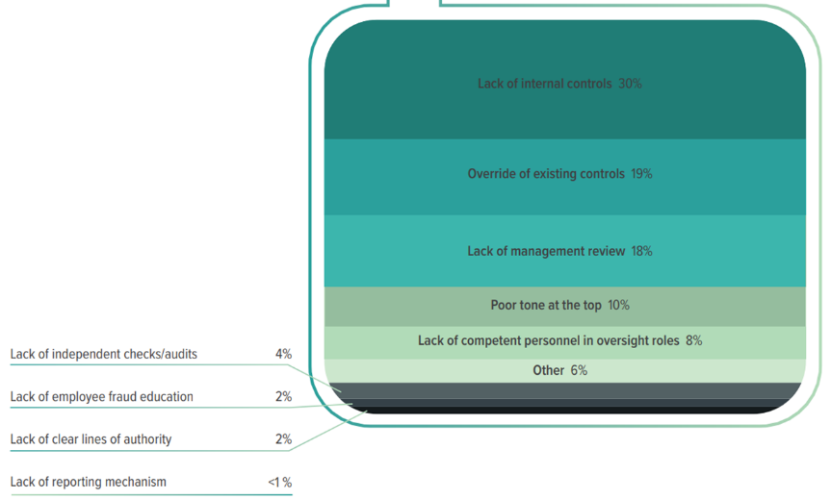
Fraud Detection (cont.)
Primary Internal Control Weaknesses (2018 Report to the Nations, ACFE)

Slide 18
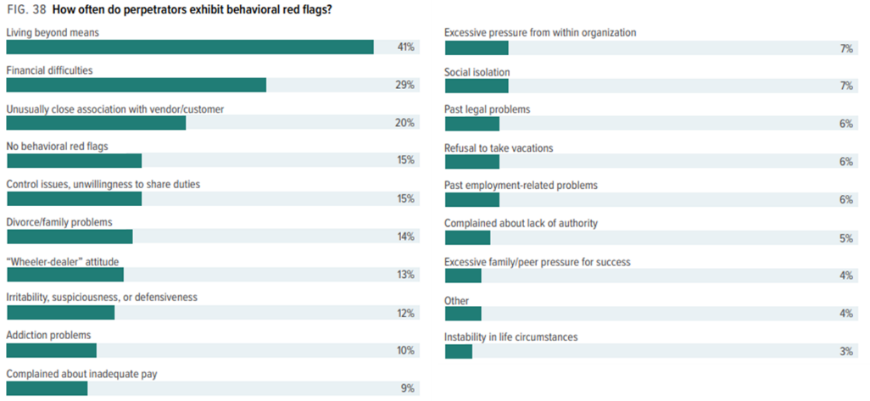
Fraud Detection (cont.)
Behavioral Red Flags (2018 Report to the Nations, ACFE)

Slide 19
Five Key Internal Control Activities
1. Segregation of Duties
Divide responsibilities between different employees so one individual doesn’t control all aspects of a transaction.
Reduce the opportunity for an employee to commit and conceal errors (intentional or unintentional) or perpetrate fraud.

Slide 20
Five Key Internal Control Activities (con.)
2. Documentation
Document and preserve evidence to substantiate:
Critical decisions and significant events...typically involving the use, commitment, or transfer of resources.
Transactions…enables a transaction to be traced from its inception to completion.
Policies & Procedures…documents which set forth the fundamental principles and methods that employees rely on to do their jobs.

Slide 21
Five Key Internal Control Activities (con.)
3. Authorization and Approvals
Management documents and communicates which activities require approval, and by whom, based on the level of risk to the organization.
Ensure that transactions are approved and executed only by employees acting within the scope of their authority granted by management.

Slide 22
Five Key Internal Control Activities (con.)
4. Security of Assets
Secure and restrict access to equipment, cash, inventory, confidential information, etc. to reduce the risk of loss or unauthorized use.
Perform periodic physical inventories to verify existence, quantities, location, condition, and utilization.
Base the level of security on the vulnerability of items being secured, the likelihood of loss, and the potential impact should a loss occur.

Slide 23
Five Key Internal Control Activities (con.)
5. Reconciliation and Review
Examine transactions, information, and events to verify accuracy, completeness, appropriateness, and compliance.
Base level of review on materiality, risk, and overall importance to organization’s objectives.
Ensure frequency is adequate enough to detect and act upon questionable activities in a timely manner.

Slide 24
Five Key Internal Control Activities – Group Reflection
Open Question:
Of the five areas just reviewed, what are the areas your organization does best?
(Segregation of Duties, Documentation, Authorization and Approvals, Security of Assets, Reconciliation and Review)
Of the five areas just reviewed, what are the areas your organization could use the most improvement?
(Segregation of Duties, Documentation, Authorization and Approvals, Security of Assets, Reconciliation and Review)

Slide 25
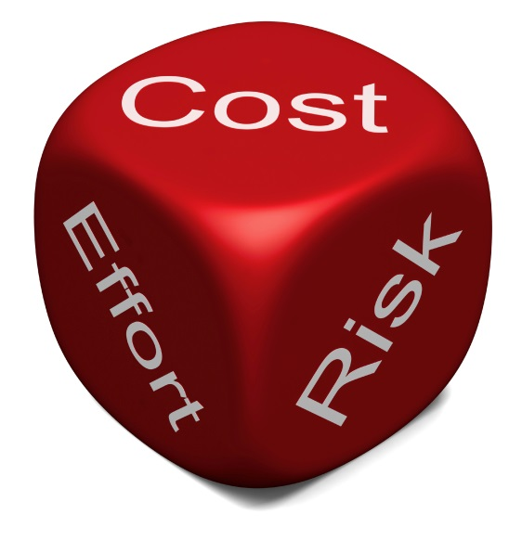
What are limitations are inherent in internal controls?
Cost benefit considerations
Sometimes too costly to justify
Potential for management override
Most always present
Risk of collusion
Opportunity
Rationalization
Pressure

Slide 26
Evaluating specific control-related policies and procedures

Slide 27
Evaluating specific control-related policies and procedures
Why is there a need to periodically evaluate controls?
Practical outgrowth of monitoring
Internal controls not a “one time” effort
May not be practical to review every control each year
What is the first step in the process of evaluating controls?
Document control-related policies and procedures to identify weaknesses and compensating controls
Start with existing documentary sources
Follow up (inquiries and walkthrough)

Slide 28
Evaluating specific control-related policies and procedures
What is the best way to identify potential control weaknesses?
Use traditional financial reporting assertions
Existence or occurrence (everything that is reported is true)
Completeness (nothing is missing)
Rights and obligations (things are what they appear to be)
Allocation (right period/right accounts)
How to identify potential compensating controls?
Identify controls by class
Authorization - who is authorized by Board and Management - prior authorization is key
Properly designed records - sequential numbering, voided items maintained
Security of assets and records - “checkouts”, physical inventory, restriction of access, passwords

Slide 29
How to identify potential compensating controls?
Segregation of incompatible duties – most widespread
Separate
Authorization
Record-keeping
Custody
Alternatives
Mandatory vacation
Mandatory rotation of duties
Analytical review

Slide 30
How to identify potential compensating controls?
Periodic reconciliations and verification performed by third parties, inventories of fixed assets, confirmations of receivables and payables.

Slide 31
Story Time!

Slide 32
Other Stories
St. Johns County Sheriff’s Office
St. Johns County Sheriff’s Director of the St. Johns County Sheriff's Office's financial services division wrote 63 checks written to four fictitious vendors totaling $673,422 from 10/10/13 – 11/7/18
Nine checks totaling $28,743 made payable to a St. Augustine address that did not exist. Someone with a similar last name who is a former in-law lived on that street, and the name they were written to was close.
A similar situation was made payable with 16 more checks totaling $292,676.
27 more checks totaling $296,452, issued to employee’s father, the name and address a slight variation of his.
More checks totaling $55,550 were issued to a Virginia location for “opioid or fentanyl” training, which no one at that address does.
Three checks written off the Sheriff’s Office’s benevolence fund for $14,000, made out to someone whose name was similar to her father’s. Six more checks made out for $11,350 in cash were also written off that fund.
Copies of bank records showed $3,145 paid to employee’s father’s retirement community, $899 in car payments and $4,436 for mortgage bills, also written off the benevolence fund account.

Slide 33
Other Stories (cont.)
June 30, 2015 Agreed-Upon Procedures
All four vendors’ names had been created by Director, then set up by her staff, which she then approved.
“She advised her employees wouldn’t question her because they assumed she was doing what she was supposed to be doing. She advised if something came up she would claim it was per the sheriff so no one would question it.”
It was done “because of a financial strain on her family and that she did not realize the magnitude of this fraud until she was provided with the dollar amount.”
“Of the money she embezzled, only $9,000 remains.”
https://www.firstcoastnews.com/article/news/st-johns-sheriffs-finance-director-jailed-after-600000-plus-in-false-payments-uncovered/77-616586775

Slide 34
COSO Framework – Internal Control – Group Reflection
Open Question:
What went wrong in this example and what are ideas you have that could have prevented it?

Slide 35
Other Stories (cont.)
Holmes County Clerk of Court
An annual audit in early January led to the investigation of the Clerk of Court. The audit showed “a significant increase in travel expenses” starting at the latter part of the year.
“The investigation shows Hudson submitted travel vouchers for several conferences, Clerk of Court Operations Corporation meetings and canvassing board meetings, FDLE agents found that Hudson either did not attend the meetings or that the meetings never happened.”
Over $6,000 in fictitious invoices.
Created fraudulent hotel receipts and meeting agendas, submitting them for reimbursement.
https://www.nwfdailynews.com/news/20190321/holmes-county-clerk-of-court-charged-with-fraud

Slide 36
COSO Framework – Internal Control – Group Reflection
Open Question:
What went wrong in this example and what are ideas you have that could have prevented it?

Slide 37
Other Stories (cont.)
Nassau County
Audit revealed $1,000 was missing from the Emergency Cash-Disaster Petty Cash which was locked in a safe
“Unannounced cash count” while county budget director was on vacation
https://www.actionnewsjax.com/news/local/new-records-show-how-nassau-county-discovered-1-000-missing-from-safe/915210759

Slide 38
COSO Framework – Internal Control – Group Reflection
Open Question:
What went wrong in this example and what are ideas you have that could have prevented it?

Slide 39
Other Stories (cont.)
City of Lynn Haven, Florida
Former City Manager and Community Services Director accused of conspiring with vendors
Payment of $5 million of approved fictitious invoices for work not performed in aftermath of Hurricane Michael to ultimately submit for reimbursement from FEMA
Reduced controls in place during State of Emergency
https://www.nytimes.com/2019/11/20/us/hurricane-michael-florida-fraud.html

Slide 40
COSO Framework – Internal Control – Group Reflection
Open Question:
What went wrong in this example and what are ideas you have that could have prevented it?

Slide 42
Contact
Ben Clark, CPA
Manager
Benjamin.Clark@jmco.com
Andrew Ferguson, CPA,
Senior Accountant
Andrew.Ferguson@jmco.com
Notes:
HOW TO: Add a background - Right click on slide in the panel on the left side, select “Format background” and add an image to the background.

